Slide 1
Ch 12 Section2
Americans face hard times

Slide 2
Section focus
How did the great depression affect the lives of urban and rural Americans?

Slide 3
Misery and Depression in the city
Few Americans understand the causes of the depression/stock market crash
Every American feels the effects

Slide 5
Searching for a Job and a meal
1921-1929 unemployment = 3.7%
1933 unemployment = 25%
People who keep jobs have hours/wages cut
Up to 30$ less
Lose houses
Loss of jobs leads to hunger
Bread lines

Slide 6
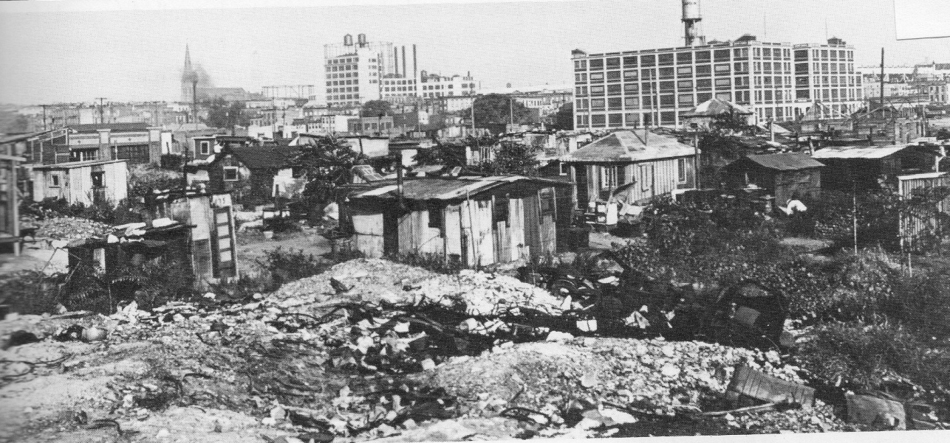
Hoovervilles
Groups of homeless people living in shantytowns
Largest in central park nyc
Covered themselves with newspapers = “hoover blankets”
Pockets inside out = “hoover flags”

Slide 7
Poverty devastates rural America
Falling prices and accumulating debt cripple farmers
1919 wheat = $2.16/bushel
1932 wheat = $0.38/bushel
1030-1932 1 million farmers lose farms
New debts added to old debts
Farmers traveled the country looking for work

Slide 8
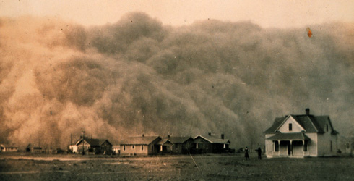
Dust bowl
1930’s drought adds to farming problems
Irrigation always done been a concern in midwest
Intensive farming practices make conditions worse
Giant dust storms sweep across midwest

Slide 9
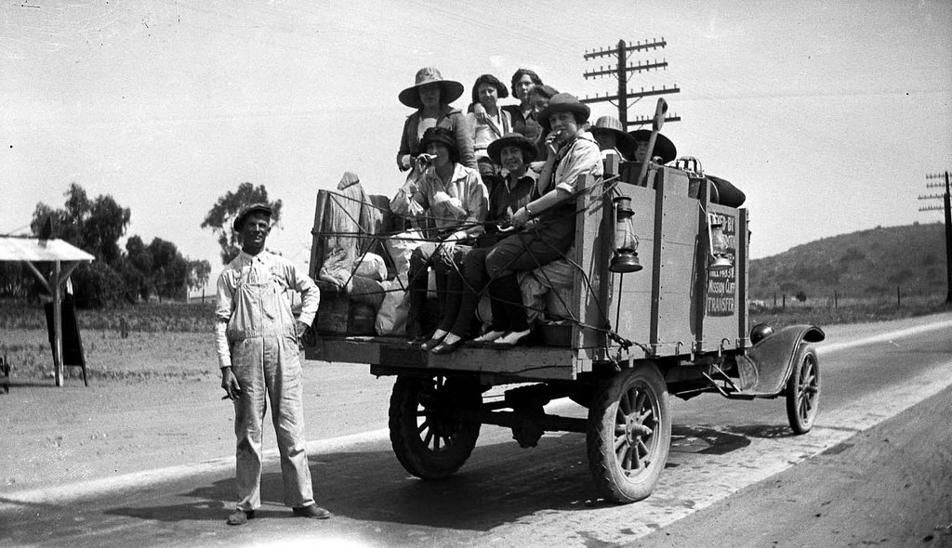
Desperation causes Migration
People leave midwest after losing farms
Refugees called “Okies”
800k leave OK, Ark,TX

Slide 10
Section Focus
How did the great depression affect the lives of urban and rural Americans?
The great Depression caused economic turmoil in both areas. In urban areas, production cutbacks in factories caused many people to lose their jobs and homes. Homeless communities called Hoovervilles sprang up in many American cities. In rural areas many farmers were already experiences economic troubles. The Depression caused crop prices to plummet and many farmers to lose their farms and homes.

