Slide 1
Ch 17 Section 4
Dissent and Discontent

Slide 2
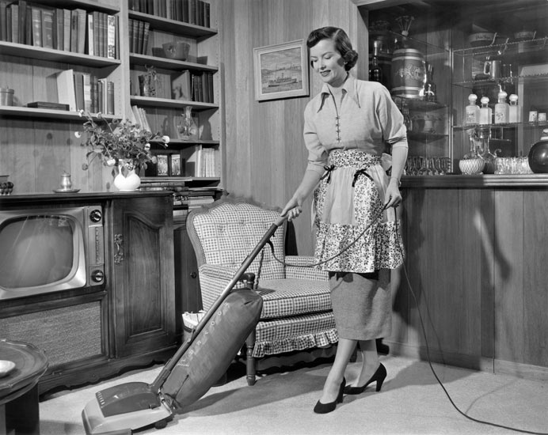
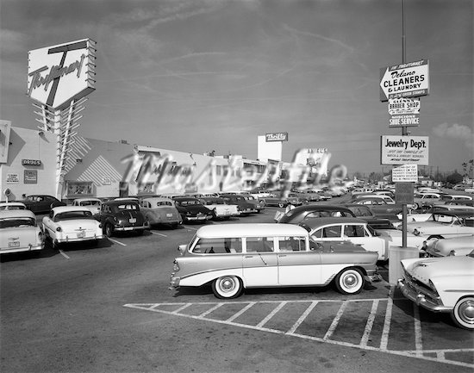
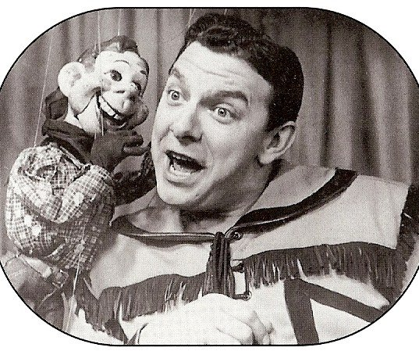
Section Focus
Why were some groups of Americans dissatisfied with conditions in post war America?

Slide 3
Rejecting 50’s Culture
Questions from critics:
Why do minorities not get equal opportunities?
Do suburbs, shopping centers, and an unending supply of gadgets represent a better life?
Does advertising have to much power to mold society?
Have Americans sacrificed their individualism in order to fit into the larger community?
Themes of alienation in literature
Catcher in the Rye

Slide 4
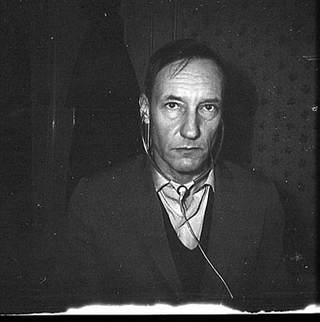
Beatniks
A group of writers/artist who refuse conform to accepted ways of dressing, thinking, and acting
Blast conformity and materialism in society
Jack Kerouac
Alan Ginsberg
William S. Burroughs

Slide 5
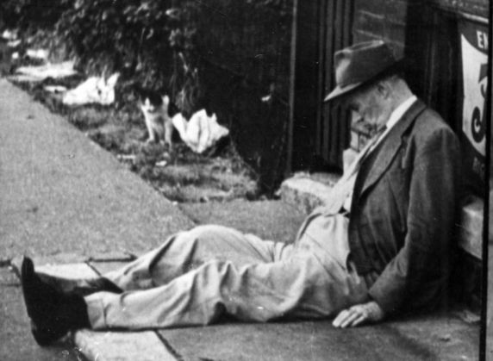
Urban poverty
Middle class move to suburbs, leaving poor in the inner cities.
Crowded neighborhoods/crime/bad schools
Lose tax revenue and political influence
Public housing projects built
1/4th of nation lives in poverty
Urban renewal projects

Slide 6
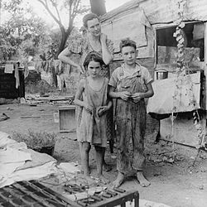
Rural Poor
Rural poor just as bad as Inner cities.
Mississippi sharecroppers
Appalachia
Small farms disappearing. Large Corporate farms replace them
Many small farmers relocate to inner cities

Slide 7
Section Focus
Why were some groups of Americans dissatisfied with conditions in post war America?
They saw that many Americans living poverty and suffering discrimination had been left out of the economic boom enjoyed by many people in the middle class. In addition, they objected conformity and consumerism.

