Slide 1
Chapter 11 Section 4
A New Mass Culture

Slide 2
Section Focus
How did mass culture reflect technological changes and social changes

Slide 3
New Trends
Cultural divide = Rural vs. Urban
Rural Leisure time
Work from dusk to dawn
Play games
Sing songs
Occasional picnic

Slide 4
New Trends
Urban Life (City)
More leisure time
(5 day work week)
Higher paying jobs
Disposable income
Automobiles

Slide 5
Motion Pictures
Movies around since early 1900’s
Studios move to Hollywood
60-120 million Americans go to movies each week
Most movies are Silent films
Ideal for immigrants who speak little English
Americas democratic art form
Anyone can afford to go to movies
Movie Stars become hugely popular

Slide 6
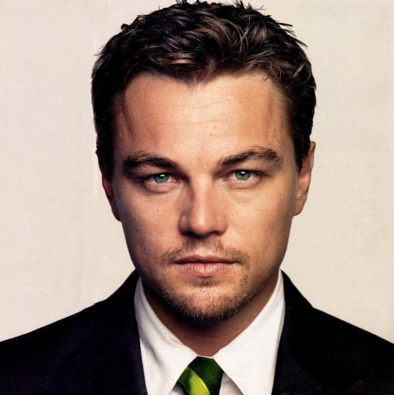
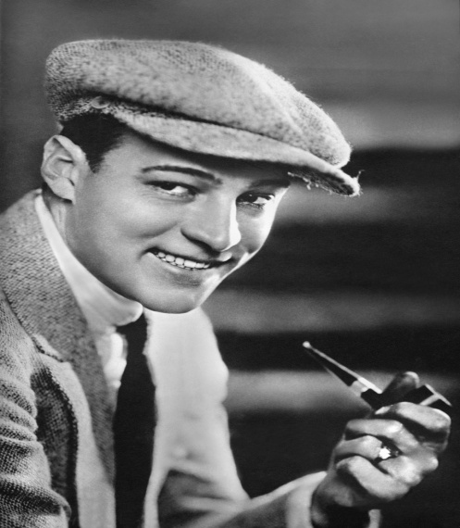
Movie Stars
Today’s top leading Man
1920’s top leading man

Slide 7
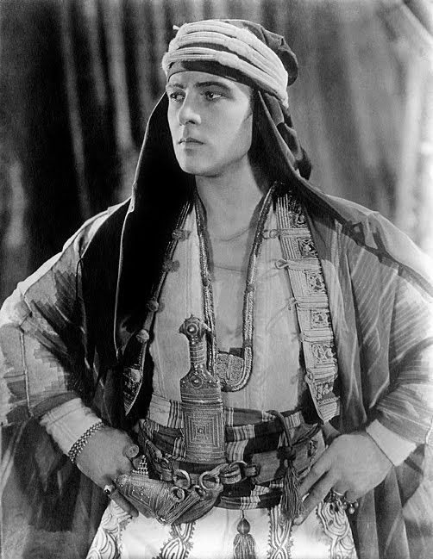
Rudolph Valentino
Handsome Romantic Lead
Italian Immigrant
Latin lover
Ladies love him
“ The Sheik”
Major movie success
Dies 1926
Complication from apendix surgey

Slide 8
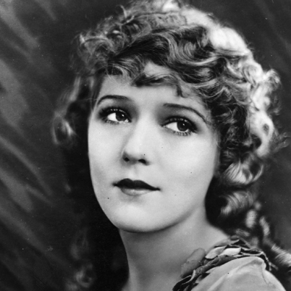
Movie Stars
Today’s top leading lady
1920’s top leading lady

Slide 9
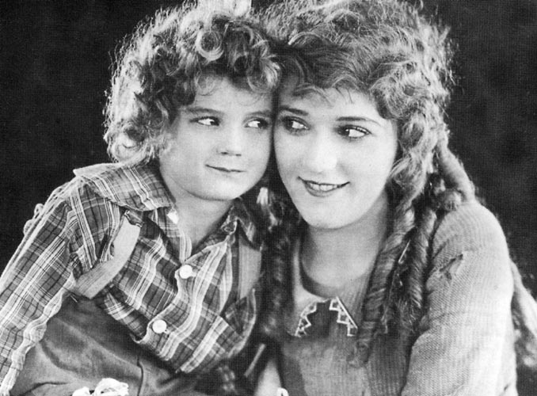
Mary Pickford
“America’s Sweetheart”
“It Girl”
“girl with the curls”
Life in Tabloids
Very successful business woman

Slide 10
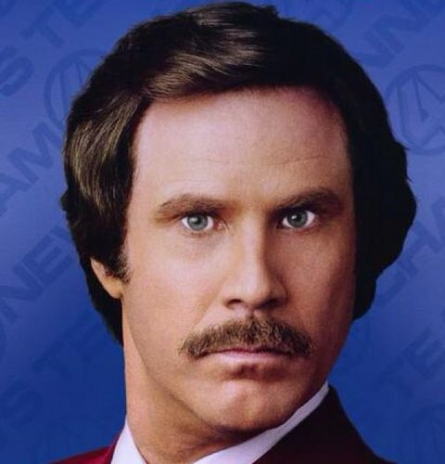
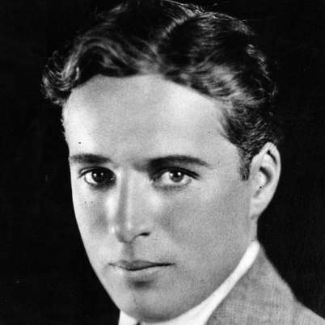
Comedy Genre
Top comedy actor
1920s top comedy actor

Slide 11
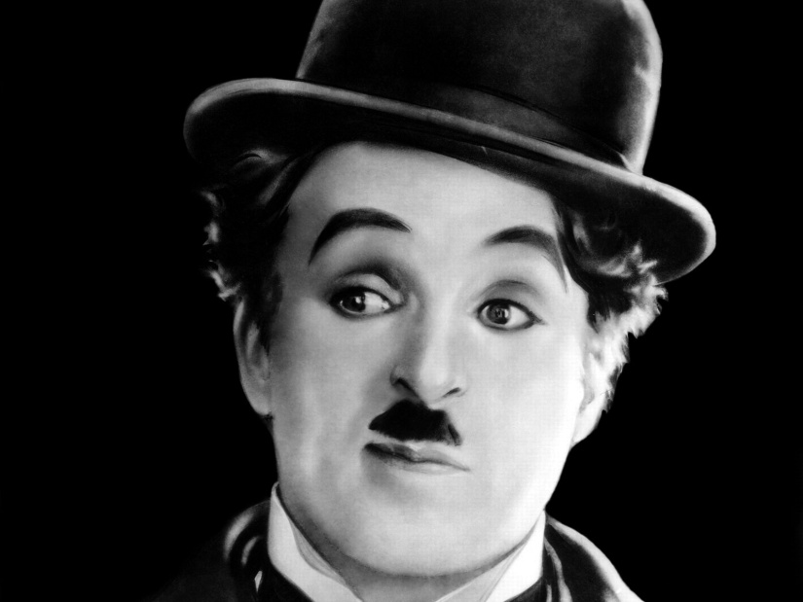
Charlie Chaplin
“The Little Tramp”
Portrayed ordinary folks
Very funny
Great director
“The Gold Rush”

Slide 12
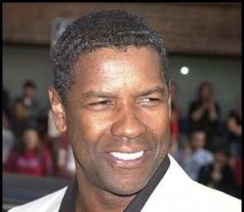
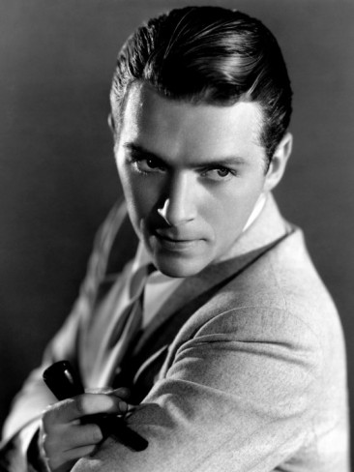
Top Action Stars
Today’s top action star
1920s top action star

Slide 13
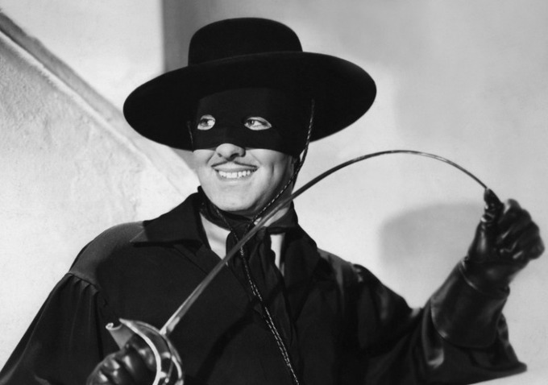
Douglas Fairbanks
“Robin Hood”
“Mark of Zorro”
Married Mary Pickford
King of Hollywood

Slide 14
Popular movies of the 1920s

Slide 15
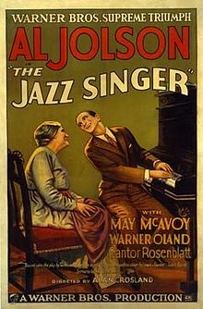
The Jazz Singer
1927 first movie with sound
“Talkies”
“you ain’t heard nothing yet”
Silent movies fade from popularity

Slide 16
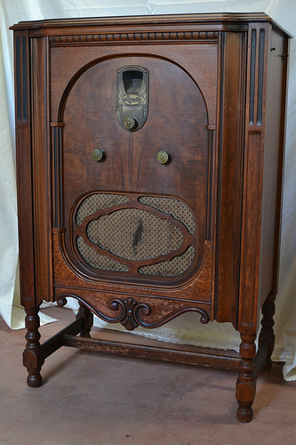
Radio
Developed in 1890
1920 KDKA
Nations first radio station
Pittsburgh Penn.
1923
600 stations
News, weather, adverts
1927 Boxing Match
Gene Tunney vs Jack Dempsey
Huge national coverage

Slide 17
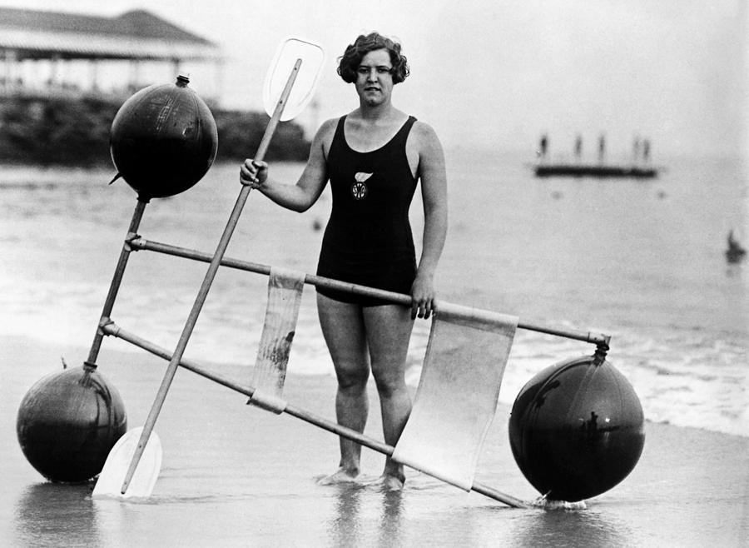
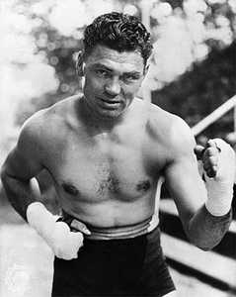
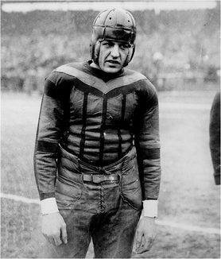
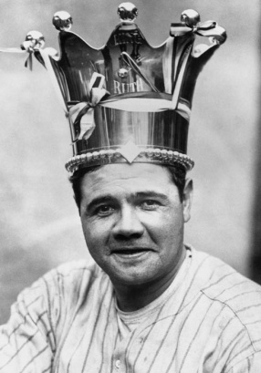
Age of Heroes
Hollywood’s chief rival in creating heroes = sports
Pre 1920’s sports heroes are locals
Radio+Magazines coverage = National sports heroes
“golden age of sports”
Golden age of sports writers
America is ready for heroes post WWI

Slide 18
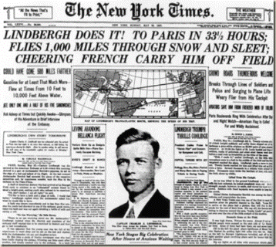
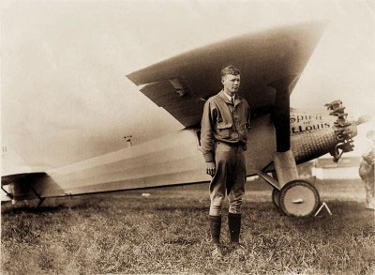
Lindbergh Crosses Atlantic
Charles Lindbergh pilot
“Lucky Lindy”
1st solo non-stop flight across Atlantic Ocean
33 hrs
Greatest Hero of the Age

Slide 19
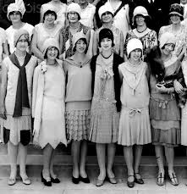
Women Assume New Roles
1800s-early1900’s women expected to center life around home and family
Many women enter workforce during WWI
Get a taste of freedom/respect
“Flappers”
Women who reject traditional morality and manners
Cut hair short “bob”
Not all women flappers
Want more control over lives and get it

Slide 21
Firsts for American Women
1920 –1st state judge
1st woman automotive engineer
1922 – 1st woman Senator
1924 – 1st woman govenor

Slide 22
Section Focus
How did mass culture reflect technological changes and social changes
Movies, radio, and records all reached a national audience, and created celebrities and trends at the same time across the country. The new American society was reflected in action movies and radio shows, and fast dance music on records

