Slide 1
Chapter 13 Section 3
Effects of the New Deal

Slide 2
Section Focus
How did the New Deal change the landscape of the United States for future generations?

Slide 3
Why it Mattes
New Deal changed role of federal gov’t in economy, the power of the president, and relationship of people to their gov’t.

Slide 4
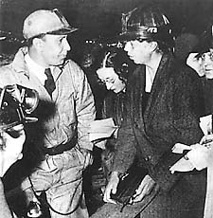
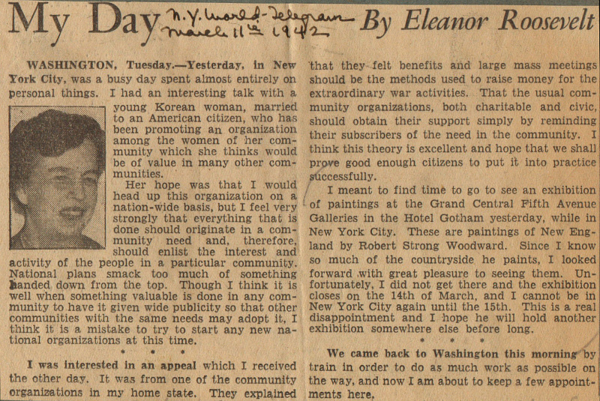
Women lead the New Deal
Eleanor Roosevelt at front. Changes role of first lady
Newspaper column, “My Day”- challenges Americans on equality
Eleanor wildly popular

Slide 5
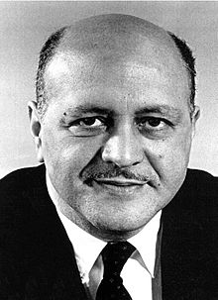
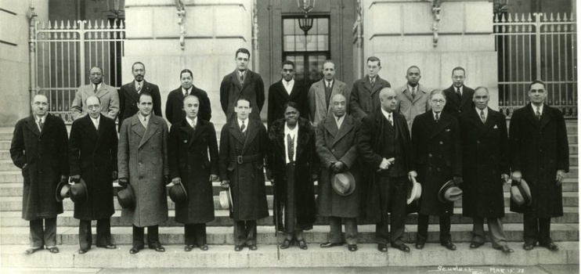
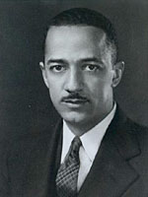
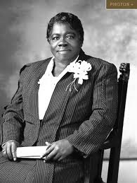
Blacks make advances / face challenges
1934 unemployment for black men = 50%
Both Roosevelts work for equality
FDR invites black advisors to white house
“The Black Cabinet”
Robert Weaver
William Hastie
Mary Mcleod Bethune
FDR refuse to go all in on Race
Refuses to support anti-lynching laws
Would lose support of southern Dems

Slide 6
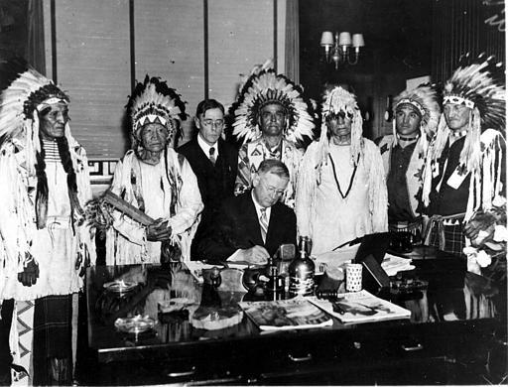
Native Americans and New Deal
“Indian New Deal”
Economic assistance
Control over own affairs
Built schools
Indian CCC
Encourages native dress, language, religion

Slide 7
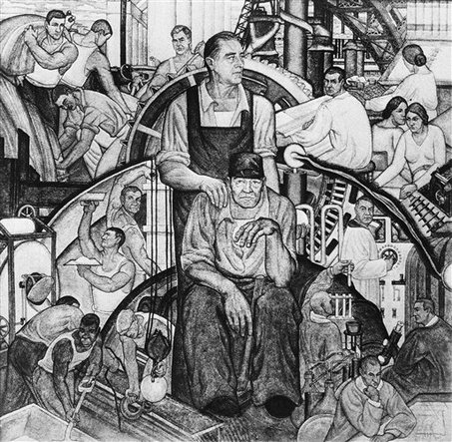
New Deal Coalition
Roosevelt allows for creation of “New Deal Coalition”
Strong political force
Southern Whites
Northern blue collar workers (immigrants)
Poor mid-west farmers
Blacks
Helps Democrats control congress during FDR terms

Slide 8
Role of Gov’t expands
Federal gov’t increases in size/power
Collecting taxes directly from paycheck
Larger Role in Economy
Ends tradition of Laissez-Faire
Govt accepts responsibility of economic growth
FDR accused of socialism

Slide 10
Welfare State
Gov’t assumes responsibility for providing for children, poor, elderly, sick, and disabled/unemployed
Most Americans had never received Federal benefits before
New Deal= Gov’t responsible for welfare of all Americans
Conservative vs. liberal debate continues

Slide 11
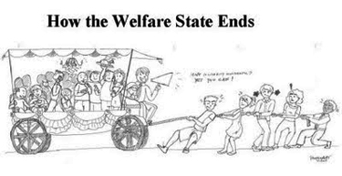

Slide 12
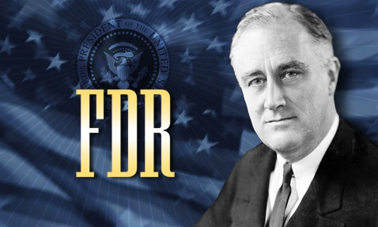
FDR changes the President
Expands role of gov’t
Increases influence of president
Makes mass media essential to presidents
Increases war-time powers
Leads to 22 amendment
Congress concerned by the growing power of the president

Slide 13
Environment
CCC and WPA both worked to help build parks
FDR gives 12 million to create more national parks
TVA = dams mixed environmental

Slide 14
Section Focus
How did the New Deal change the social, economic, and political landscape of the United States for future generations?
It forged a New Deal coalition that still influences politics today. It set the economy back on track and made the federal government the major force in the economic system. It also brought about the rise of the welfare state

