Slide 1
Chapter 17 Section 3+4
Mass Culture and Family Life

Slide 2
Writing assignment 5 minutes
Describe the “ideal” American family in 2013. How does your family compare to the “ideal” American family.

Slide 3
Section Focus
How did popular culture and family life change during the 1950’s?

Slide 4
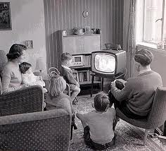
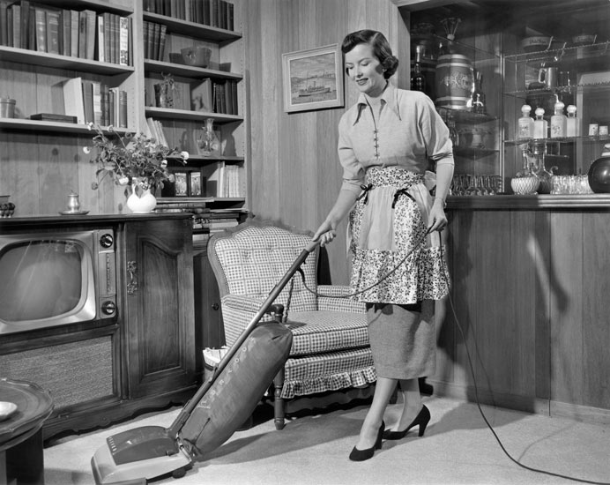
Ideal Family of 50’s
Men work
Women stay home raise children
Idea of “Family Values” still around today?

Slide 5
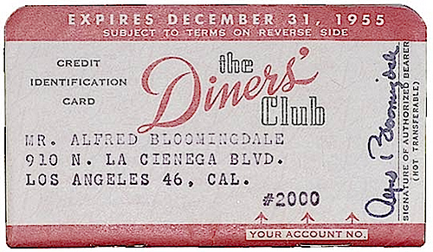
Consumerism
Economy booms …………. Americans Consume!
Postwar era + Consumerism
Americans buy on credit
Americans make more ……Spend More
Median income 1950 = $3,319
1959 = $5,417
Diners Club
First credit card
What do you buy?

Slide 6
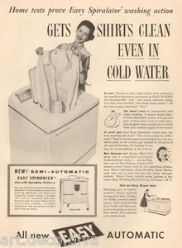
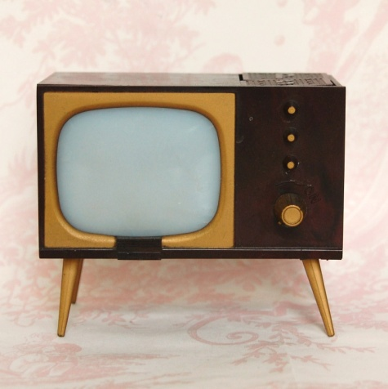
What to Buy?
1. Home appliances
Washers/dryers/ranges
Less work for housewives
2. Television
1946= 6,000 sets
1953= 7 million
3. shopping centers pop up in suburbia

Slide 7
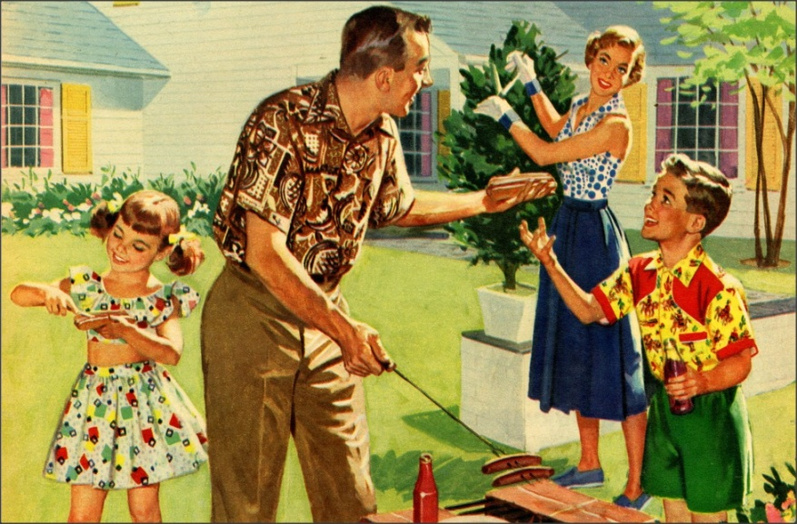
Family Life in 50’s
Post war women leave jobs go back to homemaking
Social pressure to return
Women raise kids
Men = bread winners
“Nuclear Family”
To function correctly, women must accept role!
Women challenge roles

Slide 8
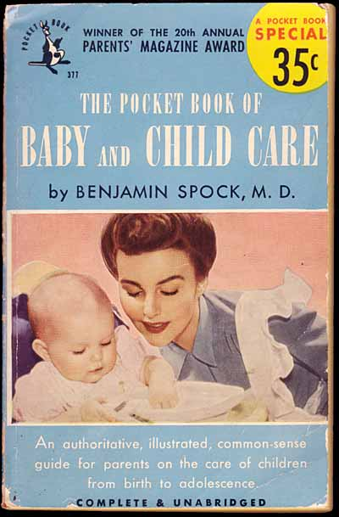
Chudrens!
Family life revolves around children!
Dr. Spock
Best selling book
Nurture/ don’t worry about spoiling child

Slide 9
Jesus
People go back to church
Churches in suburbs
Billy Graham
Fulton Sheen

Slide 10
Healthcare Improves
1954 Polio
Jonas Salk invents polio vaccine
Almost eliminates disease
Antibiotics
Penicillin
Better Diets lead to longer life expectancy

Slide 11
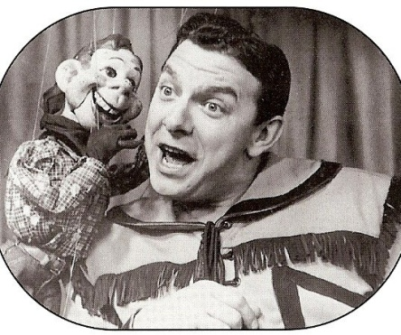
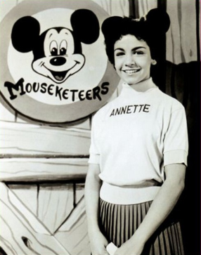
Television
Television attracts children (shows family oriented)
Howdy Doody
Mickey Mouse Club
I Love Lucy
50 million watch each week
“No family problem too great it cant be solved in 30 minutes”
1952 Presidential campaign
Canidates with more $$$= more TV time

Slide 12
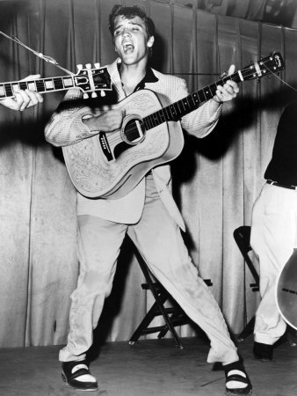
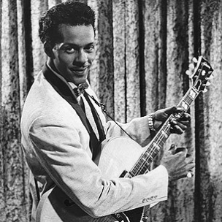
Rock n’ Roll
1951 “race” music becomes Rock n’ Roll
Borrows form African American music
Rhythm and Blues (R&B)
Radio brings R&B to white audiences in South
Jim Crows laws keep music segregated
Chuck Berry
Elvis Presley hears in Mississippi
Congress holds hearings about Rock n Roll

Slide 13
Section focus
How did popular culture and family life change during the 1950’s?
Nationally broadcast TV and radio shows, as well as movies seen nationwide, helped erode regional and ethnic differences. Television programs influenced American values and resulted in many Americans buying the same products. Rock n roll music also became the music for the younger generation all over the country. Families became more child centered and church going.

