Slide 1
Chapter 3
Section 2
Lincoln, Secession, and War

Slide 2
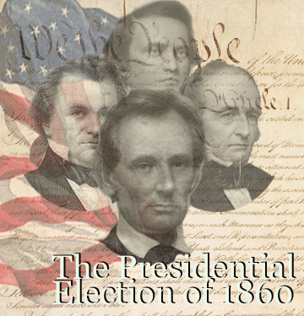
Election of 1860
Political Climate of 1860
North
Loss of confidence in Supreme Court (Dred Scott)
Fugitive slave Act (anger over states rights)
South
Worried about northern radicals (John Brown)
Elimination of slavery worries (States and Territories)
Way of life is under attack

Slide 3
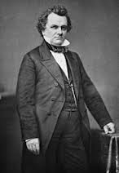
Democrats
Argue about slavery for 10 days at convention
Held in Charleston South Carolina
Northern Democrats (Stephen Douglas)
Popular Sovereignty
Southern Democrats
Want federal protection of slavery
Southern Democrats walk out of convention
Democratic party splits

Slide 4
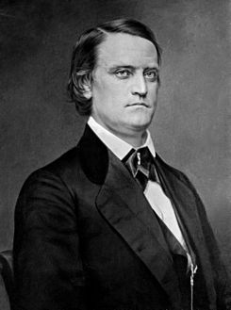
Southern Democrats
Hold their own convention
Nominate John C Breckinridge (KY)
Committed to expanding slavery

Slide 5
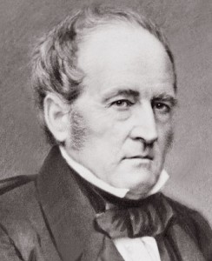
Constitutional Union Party
Condemned sectional parties
Promised to uphold the “Constitution, the Union, and the Laws”
Nominate John Bell (Tn)

Slide 6
Republicans
Called for end of slavery in territories
No interference with slavery in southern states
Abraham Lincoln nominated
Moderate views
Great debate skills
integrity

Slide 7
Lincoln Wins
40% popular vote
60% electoral vote
NO Electoral Votes From the South
Not even on the ballot in 10 southern States
Benefits from fragmented parties

Slide 8
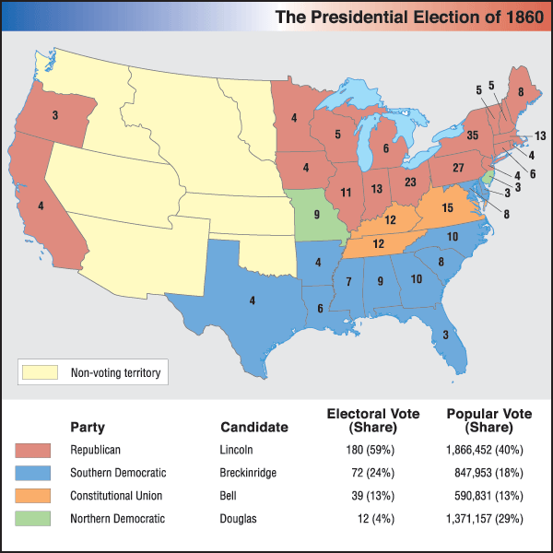
Election Breakdown (no longer national parties)

Slide 9
Union Collapses
South outraged that president elected w/out a single southern vote
No longer have a voice in the national government
States Leave
Lincoln confirmed = South Carolina leaves Union
“Presidents opinions and purposes are hostile to slavery”

Slide 10
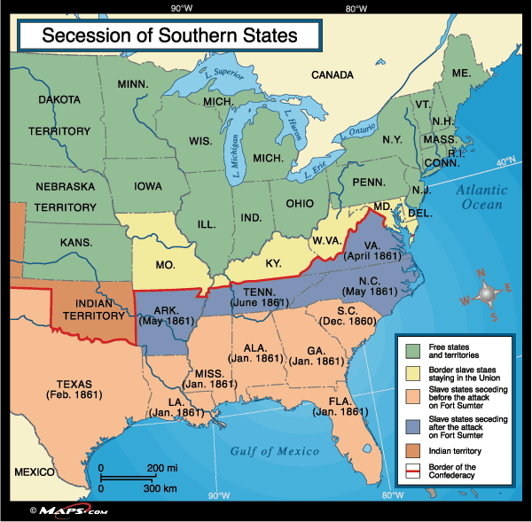
Southern Secession

Slide 11
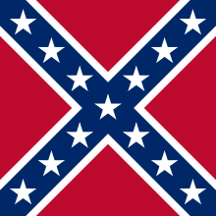
Confederacy
Feb. 1861
7 seceding states form Confederate States of America
(SC,GA, ALA, MS, FL, LA, TX)
Draft Constitution (Protects Slavery)
Elect Jefferson Davis (MS) President
Prohibits importing slaves (UK+France)

Slide 12
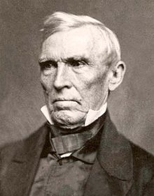
Final Compromise Fails
Crittenden Compromise
Calls for amendment allowing slavery in in Southwest
Federal funds to reimburse slaveholders for unreturned slaves
Price of a slave $1,800
Slave population is 4 million
7,200,000,000
Lincoln doesn’t like plan
Plan fails

Slide 13
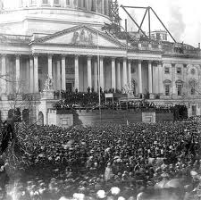
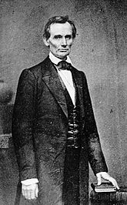
Civil War Begins
Lincoln takes office
Says there will be no war unless the South starts it
Appeals to the South to live in peace

Slide 14
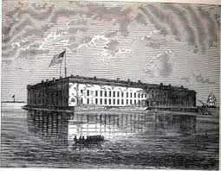
Fort Sumter
Southern states seize federal forts in their states
Fort Sumter (SC) holds out with Union troops
Sends resupply ship against SC wishes
Sc fires on Fort Sumter
Fort Sumter falls
Lincoln calls for 75,000 troops to fight Confederates

Slide 15
Reaction
VA, Ark, TN, and NC join CSA
Both sides predict a short war , only a few weeks or months

Slide 16
Conclusion
How did Lincolns election reflect the break between the North and the South?
Because he won without a single southern electoral vote
Why did the states of the Deep South leave the Union?
Lincoln’s election persuaded people in these states that the federal government would not consider their views and interest. Feared Lincoln would abolish slavery
What event led to the outbreak of war?
The Confederate attack on Fort Sumter

