Slide 1
The Rise of Big business
Chapter 4 section2

Slide 2
Section focus
How did big business shape the American economy in the late 1800’s 1900’s?

Slide 3
Corporation
Until mid 1800’s business run by families
Locally owned
Railroads provide new access to materials/customers
Corporation
number of people share ownership of a business
Same rights as an individual
Buy sell property
Sue in courts

Slide 4
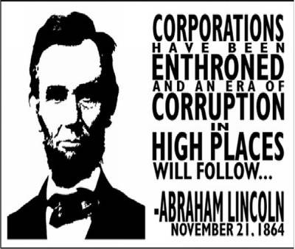
corporations
Maximize profits
Decrease costs of producing goods
Pay workers the lowest wage possible
Use advertising

Slide 5
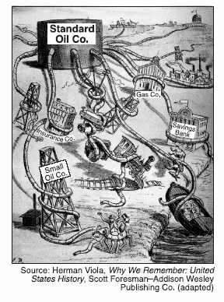
monopoly
Monopoly gaining complete control of a product or service .
No other choice for consumers

Slide 6
Cartel
Businesses making the same product agree to limit production in order to keep prices high

Slide 7
Horizontal Integration
Consolidating many firms into one business
Pg 110 in book
Trust
Companies assign stock to board of trustees, who combine them into a new organization
John Rockefeller

Slide 8
Vertical Integration
Gaining control of the many different businesses that make up all phases of production
Pg 111 in book
Andrew Carnegie

Slide 9
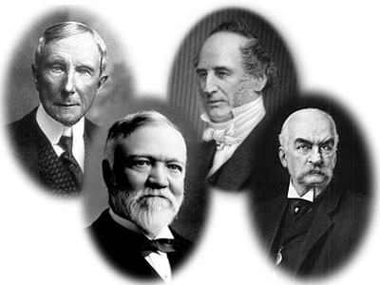
Robber Barons
People begin to feel cheated by monopolies, trusts and cartels

Slide 10
Captains of Industry
Business leaders serve the nation by providing jobs, developing new technology, shaping US into world power
Philanthropists
Build schools, museums, and libraries

Slide 11
Social Darwinism
1859 Charles Darwin
On the Origin of Species
Social Darwinism
Wealth was a measure of one’s inherent value and those who had it were the most fit.
Used to justify all sorts of beliefs and conditions
Wrong for gvt to assist the poor

Slide 12
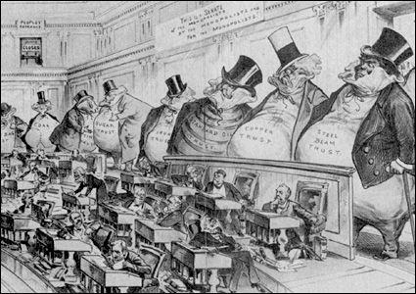
Government Regulation
Interstate Commerce Commission
1st federal body set up to regulate business
Monitors railroads
Sherman Anti-trust Act
Outlawed any trust that operated in restraint of trade
Often used against labor unions

Slide 13
Section focus
How did big business shape the American economy in the late 1800’s 1900’s?
Big business manipulated markets to maximize profits, formed corporations to avoid losses, created monopolies and cartels, and used vertical integration to control markets and eliminate competitors. These tactics often favored national businesses to the detriment of local, family-owned businesses.

