Slide 1
Chapter 6 Section 3
Transforming the West

Slide 2
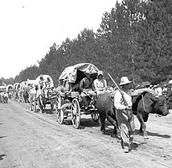
Section Focus
What economic and social factors changed the West after the Civil War?

Slide 3
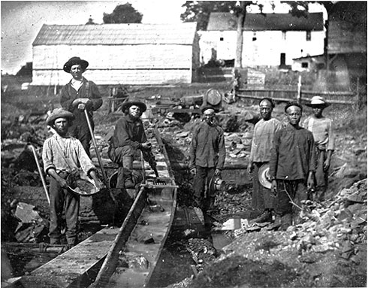
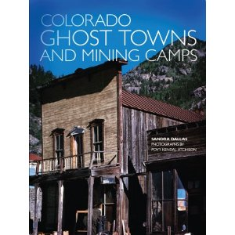
Miners hope to strike it Rich
Gold and Silver mining is the first boom in the west
People flood area from all over he world
Mining towns spring up

Slide 4
Mining Towns Spring Up
1^{st -} Discovery of gold or silver
2nd – Word spreads, people come
Area not prepared for their arrival
3rd – Mining camps, followed by more substantial communities
4th- Some look for riches mining. Other look for riches selling equipment and supplies

Slide 5
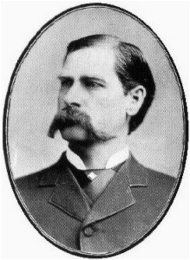
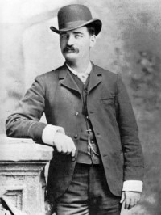
Mining Towns
No real social order early on in towns.
Miners set up rules of conduct/procedures for settling disputes
No judges or jails in these towns
Vigilantes
Self appointed law enforcers keep the peace, punish law breakers
As towns develop they hire Marshalls and Sheriffs
Wyatt Earp
Bat Masterson

Slide 6
Making Mining Big Business
2 phases of mining
1st- done by individuals mining surface soil or streambeds
2nd- Large companies mining deep underground
The Water Issue
Large scale mining uses lots of water
Water used by farmers becoming tainted and polluted
Government continually sides with big business.
Mining wealth helped fuel nations industrial development

Slide 7
Railroaders Open the West
As west grows, need for railroad to transport goods does as well
Transcontinental Railroad
Rail link between east and west
Congress expects railroad to be built by private companies
Congress provides loans and land grants to help

Slide 8
Transcontinental Railroad
1863
Central Pacific RR starts laying track east (Sacramento)
Union Pacific RR starts laying track west (Omaha)
Construction is difficult and expensive
Chinese Labor used (Central Pacific)
Little regard for their safety
Irish Labor used (Union Pacific)
Two tracks meet at Promontory Point, Utah in 1869

Slide 9
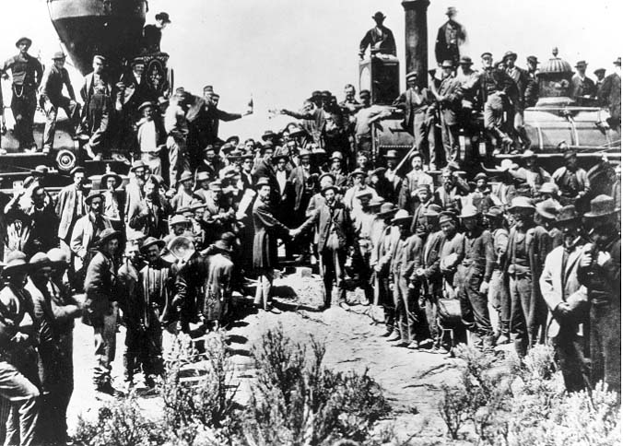

Slide 10
Railroads Intensify Settlement
Railroads now tie nation together
Stimulate growth of towns and cities
Land becomes valuable near RR lines
Whites over run Mexican Americans in Southwest
1864-1896 Ten western territories become states
Must have population of at least 60,000

Slide 11
Ranchers
West has large grassland areas suitable to feed cattle
Railroads provide way to move meat to eastern markets
Race for land and water is on!

Slide 12
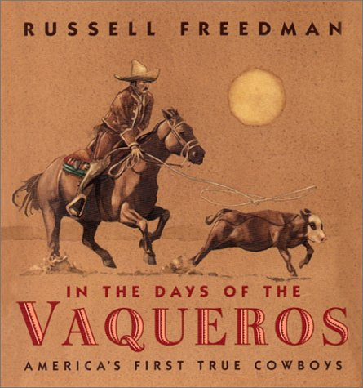
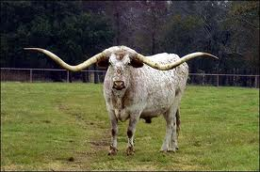
Vaqueros and Texas Longhorns
Open Range System
Cattle roamed free
Property was not fenced in
Cattle were identified by owners brand or mark
Spring comes, ranchers hire cowboys to round up the cattle
Cowboys culture evolves from the Mexican Vaqueros

Slide 13
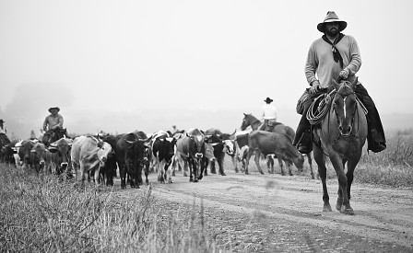
Cattle Drive
Once cowboys rounded up, they were taken to the nearest railroad for transport. Journey could take weeks or even months
Work is hard, dangerous and lonely.
Band of cowboys often made up mix of white, Mexican, and Black.

Slide 14
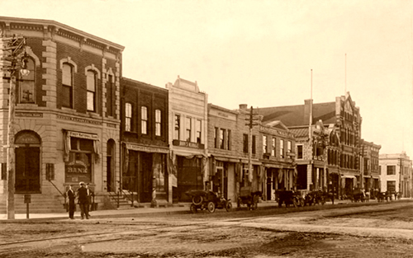
Cow Towns
Cattle drives ended in railroad towns like Dodge City, Kansas.
Cattle sold, cowboys paid.
Site of rodeo competitions

Slide 15
End of the Open Range System
System flourishes for over a decade after the Civil war
Mid 1880’s comes to an end
Invention of barbed wire makes it possible to fence in large areas.
Supply of beef larger than demand = price falls
Extreme weather of 1880’s
Ranchers begin to raise hay to feed to cattle

Slide 16
Farmers Settle on Homesteads
Great Plains last part of the country to be heavily settled by white people
Set aside for Indians
Believed to be to dry for farming
Farmers
Looking for better life
“Exodusters “ – Former slaves settling on Great Plains
Homestead Act
Government offers 160 acres of land to anyone willing to live on land for 5 years, dig a well, build a road.

Slide 17
Homestead Challenges
Life of Homesteaders is hard
Windstorms, blizzards, drought, plagues of locust, and loneliness.
Few can afford lumber, make homes out of sod
Have to solve problems on your own

Slide 18
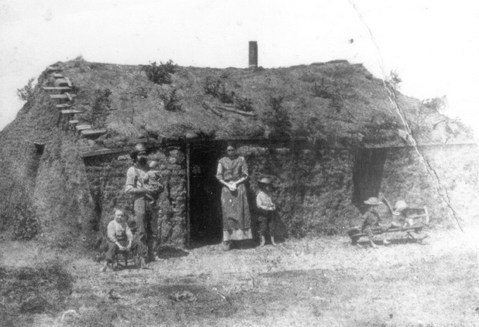

Slide 19
Competition, Conflict, and Change
Conflict
Water and land usage led to disagreements
West is most ethnically diverse area of the country
Only 20% of population
Contains 80% of nations Asian, Mexican, and Native American population

Slide 20
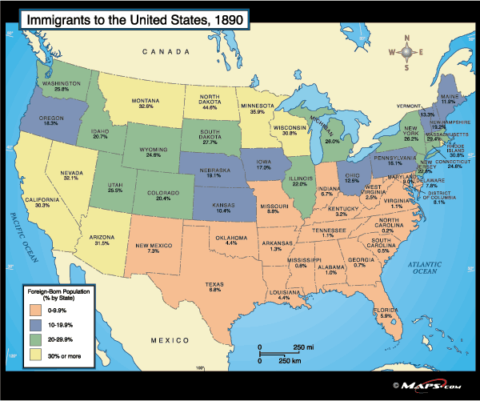

Slide 21
Closing the Frontier
Last major Land rush 1889 Oklahoma
People line up to leave on April 22
Find people already get there and claimed land
“Sooners”
1890 national census declares no frontier left in US

Slide 22
Section Focus
What economic and social factors changed the West after the Civil War?
Mining interests and companies, the extension of the railroads and the completion of the transcontinental railroad, the Indian Wars, cattle ranching, and homesteading.

