Slide 1
Chapter Section 4
The United States and Latin America

Slide 2
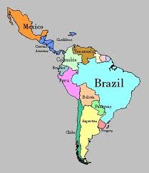
Section focus
What actions did the United States take to achieve its goals in Latin America?

Slide 3
Why?
US exerts influence more aggressive in Latin America
Leaders viewed it a “sphere of influence” that should exclude other powers
US influence will bring benefits
Will contribute to anti-American hostility
Instability in region

Slide 4
US policy in Puerto Rico and Cuba
Who will rule Puerto Rico and Cuba?
Free after Spanish American War
Puerto Rico
Foraker Act
Establishes civil government
Puerto Ricans slowly gain more control over the country

Slide 5
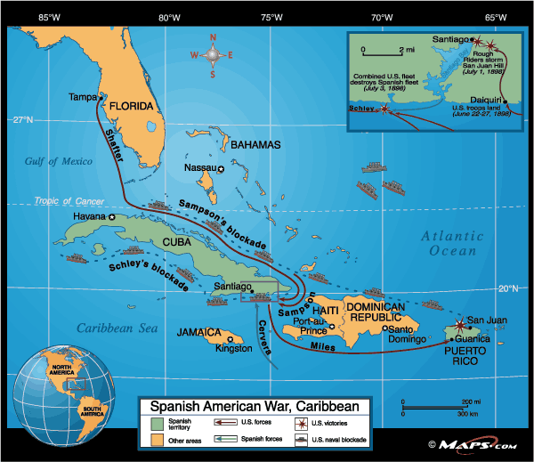
US policy in Puerto Rico and Cuba
Cuba
Platt amendment
Added to Cuban Constitution
Limits rights of Cubans
No treaties
US naval bases
“right to intervene”
US doesn’t want Cuba to become base for hostile nations

Slide 6
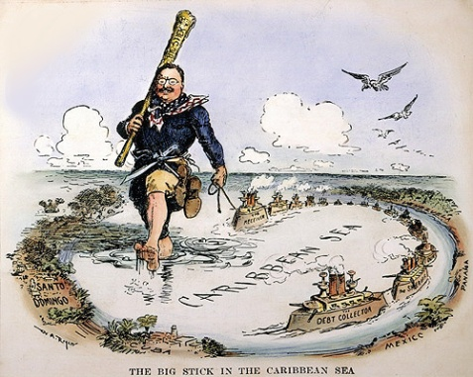
“Big Stick” Diplomacy
Roosevelt believes
US must “civilize/uplift” weaker nations
American Elites must accept challenge of international leadership
“Big Stick” Diplomacy
US policy in Latin America
“Speak softly, and carry a big stick; you will go far”

Slide 8
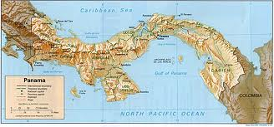
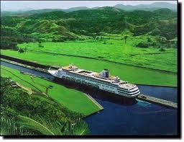
Panama Canal
Not America’s Idea
France
US buys route for $40 Million
Colombia owns Panama
Wants more $$$$
US supports insurrection in Panama
Panama gets independence
US buys canal zone for 10 million
Annual rent $250k

Slide 9
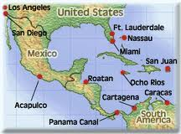
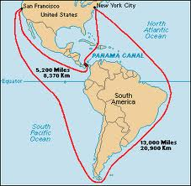
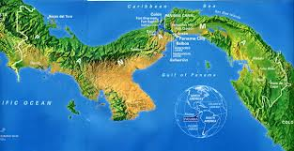

Slide 10
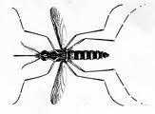
Panama Canal
35k workers
Cuts 8,000 miles off trip from eat coast to west coast
Malaria
5000 workers die
Control by
Drainage, oiling, mowing, screening, Quinine

Slide 11
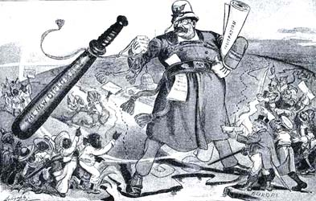
Monroe Doctrine Updated
Monroe Doctrine
Euros out of western hemisphere
US not interfere with Euro
Euros Loan money to Latin America
Send armies to force to pay debts
Roosevelt Corollary
New US policy in Latin America
“chronic wrongdoing” in Latin America will cause to assume role of police power in area.
Don’t try it!

Slide 13
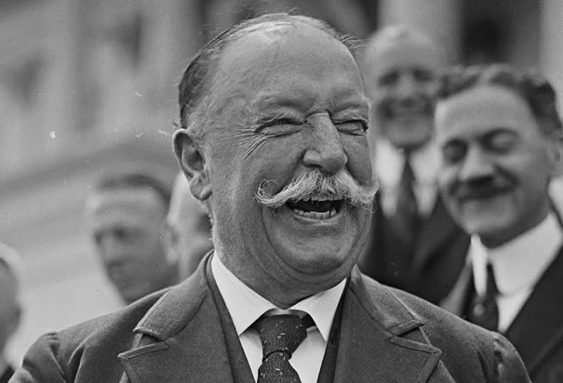
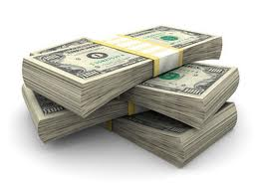
Dollar Diplomacy
William Howard Taft succeeds Roosevelt (1908)
Wants to expand trade
Maintain open door policy
Ensure Latin American stability
Dollar diplomacy
“replace bullets with dollars”
Americans invest in banks, plantations, mines, oil, railroads,

Slide 14
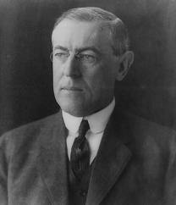
Moral diplomacy
Woodrow Wilson (D) wins presidency in 1912
Former teacher
Appoints Williams Jennings Bryan Sec. of State
Moral Diplomacy
“US will never seek one additional foot of territory”
Work to promote “human rights, national integrity, and opportunity”

Slide 15
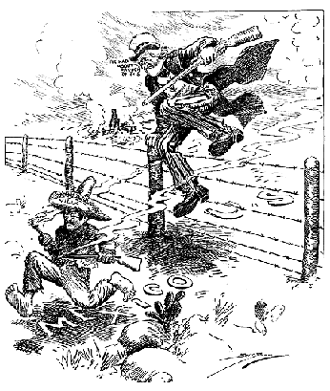
Viva La Mexico!
Revolution in Mexico
US business interests threatened
US backs reform leaders
Moral diplomacy
Pancho Villa
Mexican revolutionary
Raids town in NEW MEXCIO
General George Pershing
10k men chase into Mexico

Slide 16
Section focus
What actions did the United States take to achieve its goals in Latin America?
The United States asserted its right to police Latin America in order to prevent European intervention. Its “dollar diplomacy” used economic incentives to assert the US right to trade with Latin American countries.

