Slide 1
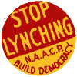
Lynching
The Power of fear and intimidation

Slide 2
Disenfranchised
1894 – Louisiana has 130,000 registered African American voters
1904- Louisiana has 1,300 registered African American voters

Slide 3
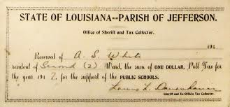
Poll Tax
Tax created to keep poor blacks from voting

Slide 4
Literacy Test

Slide 5
Grandfather Clause

Slide 6
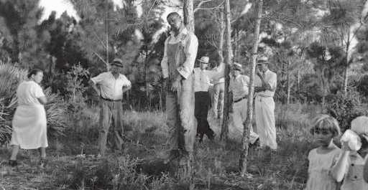
Fear and Intimidation
Lynching is an extrajudicial execution carried out by a mob, often by hanging, but also by burning at the stake or shooting, in order to punish an alleged transgressor, or to intimidate, control, or otherwise manipulate a population of people.

Slide 7
Sam Hose Lynched in Atlanta
Kills his boss in self defense April 1899
Mob cuts off ears and fingers
Body doused in kerosene, tied to tree and burned
W.E.B Du Bois is living in Atlanta, hears the knuckles of Sam Hose are for sale in a local drugstore
Ida B. Wells hires a private investigator

Slide 8
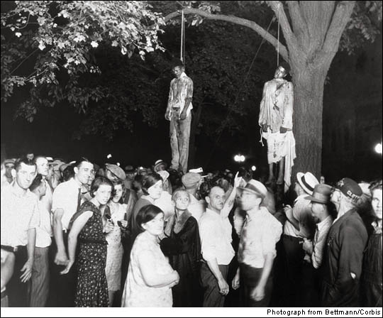
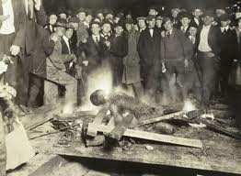
Postcards
Images of lynching's were sold as postcards and collectables at retail outlets and by mail order

Slide 10
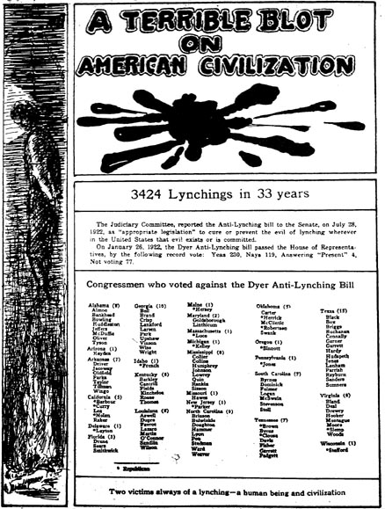
Anti- Lynching
Ida B. Wells and W.E.B Dubois begin anti lynching crusade.

Slide 13
Lynching and the Price of Cotton
What is the relationship of cotton prices to lynching’s?

Slide 14
Strange Fruit
Southern trees bear a strange fruit, Blood on the leaves and blood at the root, Black body swinging in the Southern breeze, Strange fruit hanging from the poplar trees.
Pastoral scene of the gallant South, The bulging eyes and the twisted mouth, Scent of magnolia sweet and fresh, And the sudden smell of burning flesh!
Here is a fruit for the crows to pluck, For the rain to gather, for the wind to suck, For the sun to rot, for a tree to drop, Here is a strange and bitter crop.

