Slide 1
US History
Chapter 1 , section 3 Constitution

Slide 2
United states of America
Colonist rebelled and created a new nation
Creating a system of government is the new challenge.

Slide 3
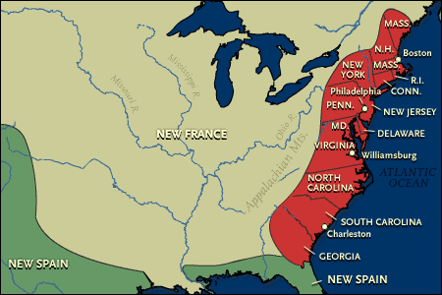
Confederation of States
Colonies become “states”
Each state writes a constitution creating republics
Voters elect representatives and a governor
Most constitutions include a bill of rights

Slide 4
Articles of Confederation
1st federal constitution adopted by states 1781
Power remains with the states
Federal Government limited powers (Locke)
1. declare war
2. regulate trade with foreign nations
3. no say in interstate commerce
4. could not levy taxes
5.

Slide 5
Articles of Confederation
Weaknesses
Federal government had to rely on contributions from states to raise money
Unable to pay off massive war debt (France)
No President
Each state, regardless of size, has vote in congress
Amending articles impossible (all 13 must approve)

Slide 6
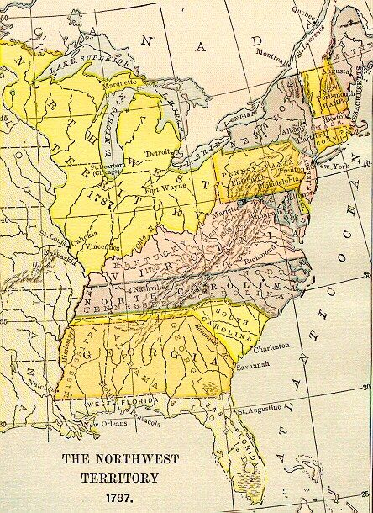
Northwest Territory
Land acquired in treaty with England
Slavery banned in this area

Slide 7
Troubles Grow
Confederation could not defend American interest on the frontier.
Spain closes Port of New Orleans
British refuse to abandon their forts in America

Slide 8
Shays Rebellion
1780s economic depression hits
Farmers paid less for crops
In Massachusetts courts seizes land from farmers when they are unable to pay taxes
Armed Farmers, led by Daniel Shays, shut down the courts. State sends troops to end the revolt
Highlights weaknesses of the Federal Government

Slide 9
Constitutional Convention
Americans agree that Articles of Confederation are flawed
May 1787 states send delegates to a special convention in Philadelphia
Two plans proposed

Slide 10
New Jersey Plan
Favored by small states (states equal)
Gives Congress power to tax and regulate commerce
States remained sovereign
States remain loose confederation rather than unified nation

Slide 11
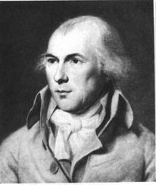
Virginia Plan
Proposed by James Madison
National Union strong and republican
Large republic “more stable; diverse interest provide checks and balances
Power to tax and regulate commerce
House of Representatives and a Senate
Features a president

Slide 12
Great Comprimise
Settles differences in in two plans
Creates a bicameral (2 houses) legislature
For smaller states, only two Senators per state
Larger states get House of Representatives based on population
What about the Southern States?

Slide 13
Great Comprimise
Sothern States fear domination by Northern states with large white populations
Three Fifths clause : Slaves counted as 3/5ths of a person. Boost numbers of Southern seats in Congress
No rights given to the slaves

Slide 14
Struggle over Ratification
9 out of 13 states must ratify (approve) Constitution
Supporters called Federalist
Write series of essays called federalist papers
Antifederalist fear too much power is given to federal government
Addition of Bill of Rights leads to ratification

Slide 15
Principles of Constitution
Federalism: power divided between nation and state
Separation of Powers : executive, judicial, and legislative ( 3 branches of government)
Checks and Balances: prevents each branch from emerging a single source of power
Amendment process: Constitution could be changed in the future

Slide 16
Notebook Question
Of all the rights guaranteed by the United States Bill of rights and Constitution, which one is the most important to you? Why?
Write a paragraph explaining your response. Be prepared to share.

